Slide 1
FAKE NEWS DETECTION
Name: Suraksha
Course: MCA
Reg No:P05AZ24S126027

Slide 2
Contents:
1.Introduction 8.Dataset Description
2.Problem Statement 9.System Architecture
3.Objectives 10.Feature Extraction
4.Motivation 11.Machine Learning Models
5.Benefits 12.Evaluation Metrics and Results
6.Challenges 13.Conclusion & Future Work
7.Application 14.References

Slide 3
Introduction
Rapid growth of internet and social media
Increase in online news content
Fake news spreads quickly
Manual detection is difficult
Machine learning enables automatic detection

Slide 4
Problem Statement
Large amount of online news data
Fake news spreads rapidly
Difficult to verify manually
Need automated detection system

Slide 5
Objectives
Build detection system
Preprocess data
Use TF-IDF
Apply ML models
Evaluate performance

Slide 6
Motivation
Increase in misinformation
Need automation
ML learning interest
Real-world application

Slide 7
Benefits
Saves time
Reduces effort
Improves accuracy
Helps users
Supports organizations

Slide 8
Challenges
Noisy data
Fake looks real
Imbalanced dataset
Feature complexity

Slide 9
Applications
Social media platforms to identify and remove fake content
News websites to verify authenticity of articles
Government agencies to prevent misinformation
Online users to check credibility of news
Election monitoring to avoid political manipulation
Fact-checking organizations for faster verification

Slide 10
Dataset Description
Dataset obtained from Kaggle and GitHub
Contains news articles (Fake and Real)
Includes multiple features such as:
Title
Text
Date
Class label:
0 → Fake News
1 → Real News
Data type: Textual (unstructured data)
Used for training and testing machine learning models

Slide 11
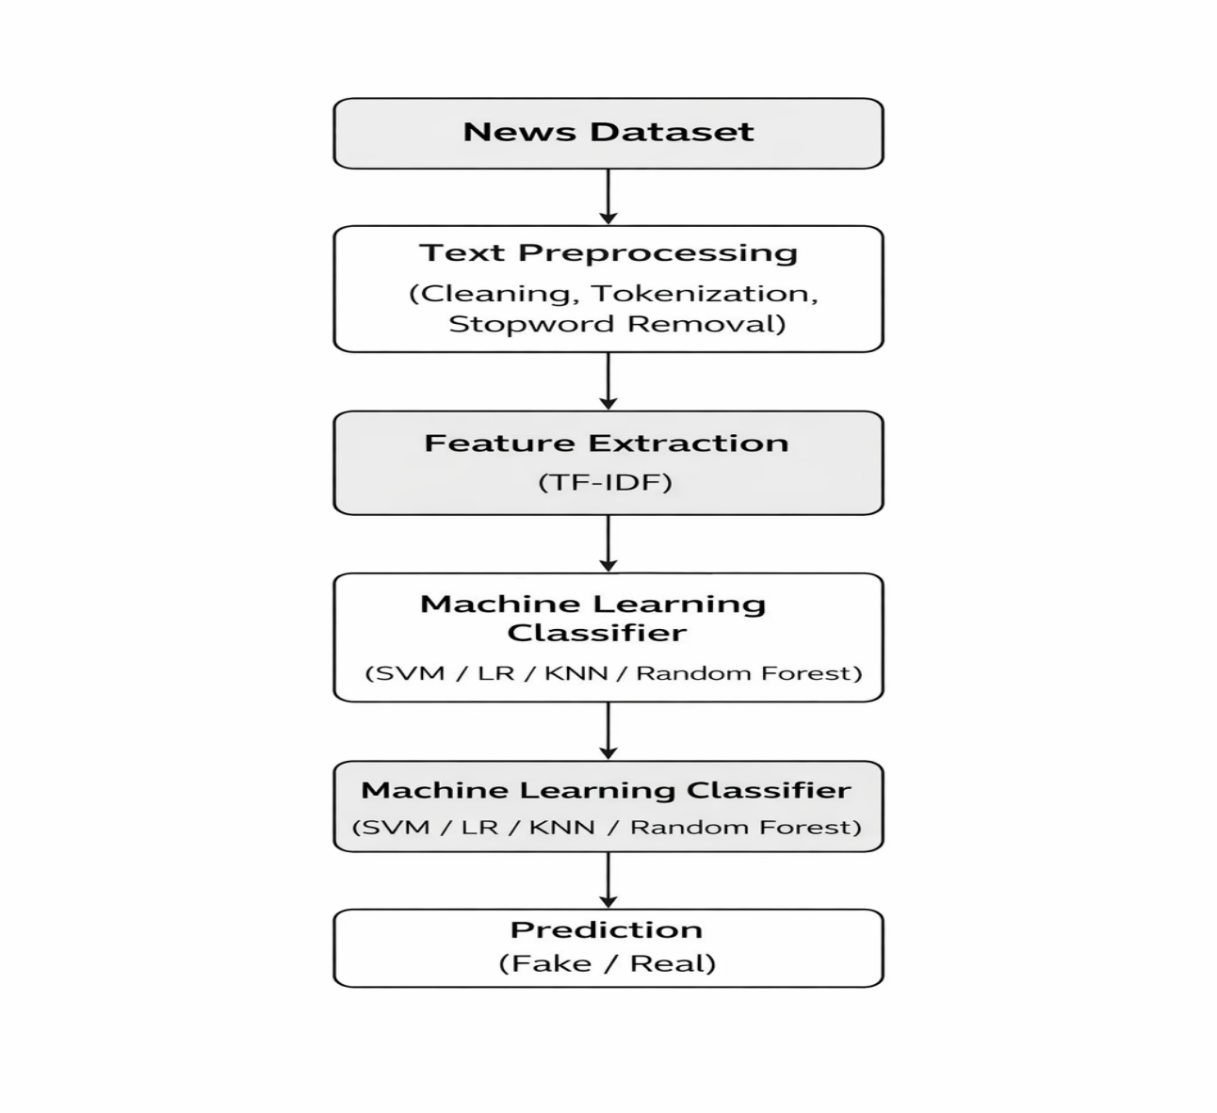
System Architecture

Slide 12
Data Preprocessing
Missing values are checked and handled
Text data is cleaned (remove special characters & punctuation)
All text is converted to lowercase
Stop words (like is, the, and) are removed
Dataset Data is converted into numerical form using TF-IDF
is split into training and testing sets (75% / 25%)

Slide 13
Feature Extraction
Important text features are selected from news articles
TF-IDF is used for feature extraction
Converts text into numerical feature vectors
Reduces irrelevant and less important words
Improves model performance Helps detect fake news patterns effectively

Slide 14
Machine Learning Models
Logistic Regression – baseline classification model
Support Vector Machine (SVM) – best performing model
Random Forest – ensemble model with high accuracy
K-Nearest Neighbors (KNN) – similarity-based model

Slide 15
Evaluation Metrics
Accuracy – measures overall correctness of the model Precision – measures how many predicted fake news are actually fake
Recall – measures how many actual fake news are correctly identified
F1-score – balances precision and recall
Confusion Matrix – shows correct and incorrect

Slide 16
RESULT
Algorithm | Accuracy | Precision | Recall | F1-score
Logistic Regression | 98.5% | ~0.98 | ~0.98 | ~0.98
SVM | 99.3% | ~0.99 | ~0.99 | ~0.99
Random Forest | 99.0% | ~0.99 | ~0.99 | ~0.99
KNN | 86.0% | ~0.86 | ~0.86 | ~0.86
Support Vector Machine (SVM) showed highest accuracy
Achieved high precision and recall
Effectively classified fake and real news

Slide 17
Conclusion
Fake News Detection system was successfully developed
Machine learning models were applied to classify news
TF-IDF improved feature extraction
SVM achieved highest accuracy (99.3%)
System provides reliable and efficient results
Helps reduce spread of fake news

Slide 18
Future Work
Use deep learning models (LSTM, CNN, BERT)
Implement real-time fake news detection system
Use larger and updated datasets
Add multilingual support
Develop web or mobile application

Slide 19
References
H. Allcott and M. Gentzkow,“Social Media and Fake News in the 2016 Election,”Journal of Economic Perspectives, 2017
K. Shu et al.,“Fake News Detection on Social Media: A Data Mining Perspective,”ACM SIGKDD Explorations, 2017
V. L. Rubin et al.,“Deception Detection for News: Three Types of Fake News,” ASIS&T Conference, 2015
P. Kumar and A. Gupta,“A Survey on Fake News Detection Using Machine Learning Techniques,”International Journal of Computer Applications, 2019

Slide 20
THANK YOU

